Slide 1

Development Process and Documentation
Week 04
Revised Proposal and Development Process
Team 07
Department of Artificial Intelligence Cyber Security
College of Science & Technology

Slide 2
Contents
Revised Proposal
Development Process
Roles We Need
Development Process
Documentation
Objection We Solved

Slide 3
Revised Proposal

Slide 4
Revised Proposal
Previous Proposal; Real-time Signal Data Scaling
Huffman Coding; Complete Binary Tree >> No need to use in complex structure
Three Approach for Proposal
Capability Improvement
New Perspective
Commercially Available
Suggested Proposal
e-mail and LoCo Protocol; Packet Compression
Tiny PE; EXE File Compression
Two-dimensional array Data Compression
Personal Mobility Vehicle Retrieval

Slide 5
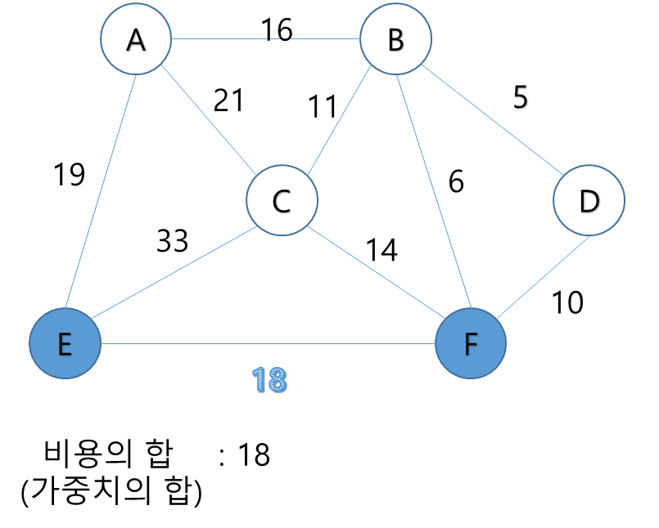
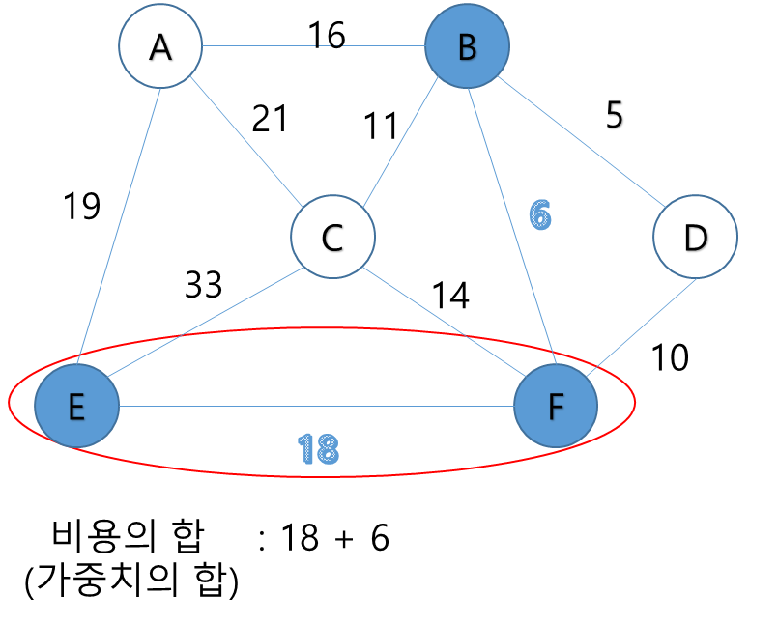
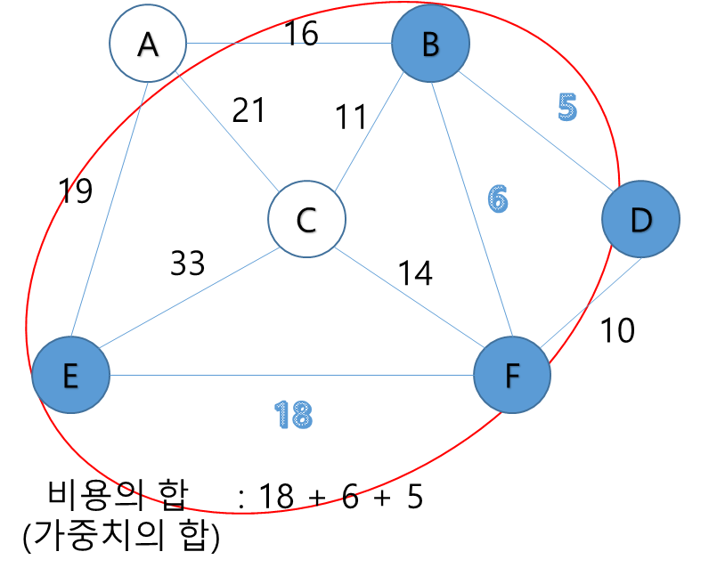
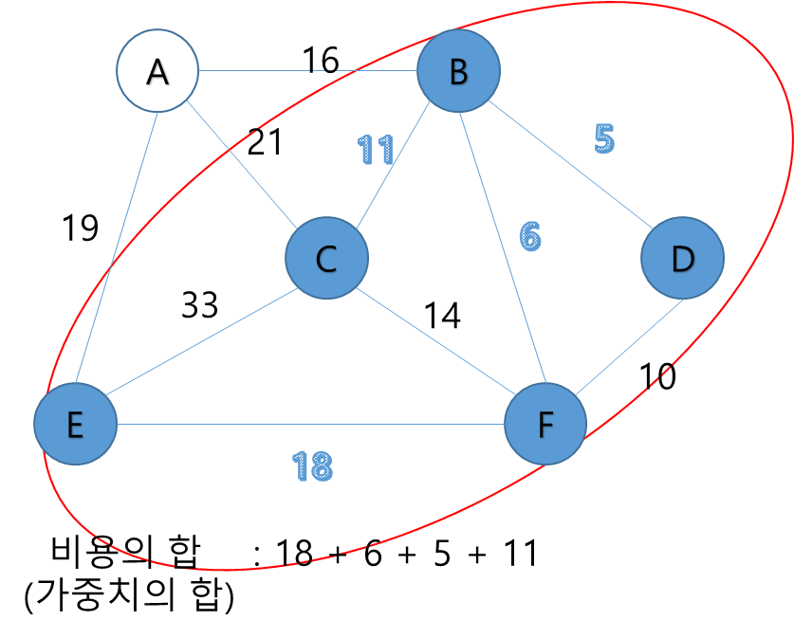
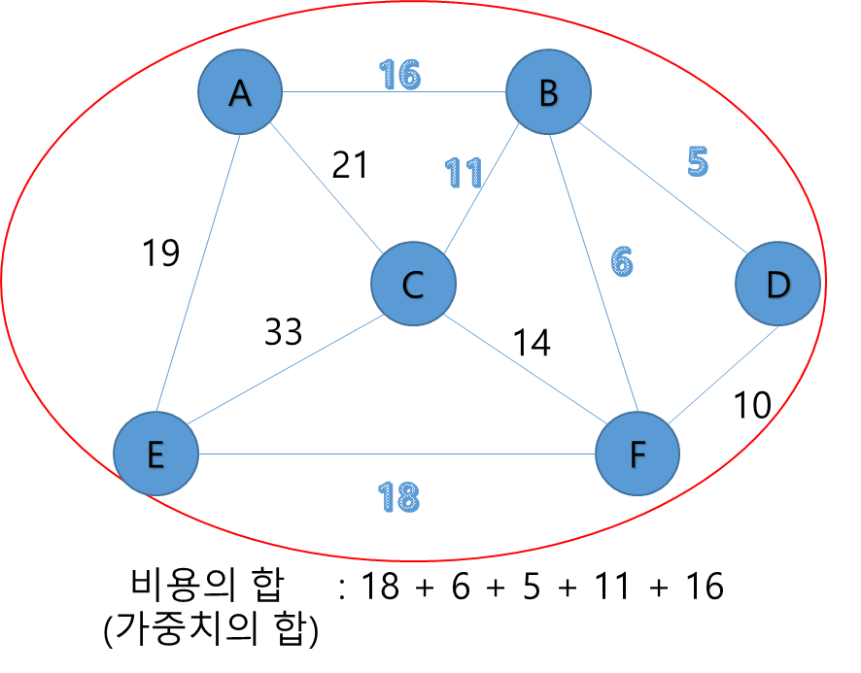
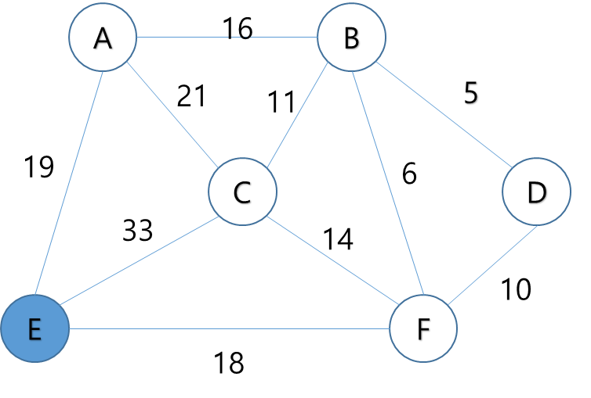
Revised Proposal
Revised Proposal; Personal Mobility Vehicle Retrieval
Two groups, which is composed by stationary node(Group A) and nonpermanent node(Group B)
According to measured road data, make several scenarios that group B is not in the same position
Categorize group B as 3 types of remaining battery capacity and recall request
Generate minimum cost spanning tree which links all node of group A and necessary node of group B
Based on DFS(Depth-First Search), can get optimal distance and time
Suggested Algorithm; Kruskal vs Prim
Kruskal algorithm repeats sorting link in ascending order by weight
Prim algorithm links lowest weighted node from start flag
Process of Prim Algorithm https://ongveloper.tistory.com/376

Slide 6
Development Process

Slide 7
Roles We Need
Frontend Dev
As long as our proposal is for real world industrious man, user interface must have good accessibility
Results from backend need to shown as Google Map API
Need JS developer, Hajun Myoung, is able to use React
Backend Dev
Can implement suggest algorithms by using Python
Structure library will be made as well
Python developer, Minse Kim, can use JS as well will be in charge
Dataset Dev
Dataset includes variable scenario of group B
Must be based on measured road data
Will be made with Python, Minchan Park will be in charge

Slide 8
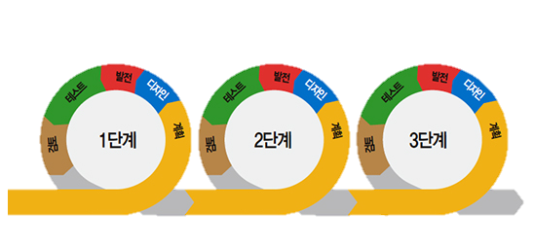
Development Process
Agile Software Development
This process is methodology that seeks to find a compromise between various development methods
Less-document Oriented, Code Oriented
Numerous prototypes will be made
Each snapshot will be reinforced every time; Adaptive Style
Steps of Agile Software Development http://www.incodom.kr/애자일_방법론

Slide 9
Documentation

Slide 10
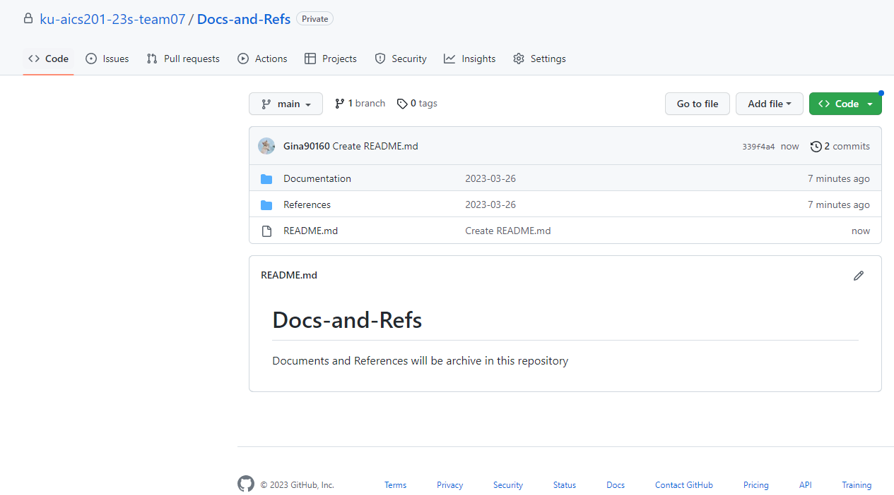
Documentation
Github Documentation
Multi Repo
https://github.com/ku-aics201-23s-team07

Slide 11
Objection We Solved

Slide 12
Objection We Solved
What is effectiveness of proposal?
Is it for industrious worker? If it is, why the companies doesn’t serve these kind of service?
What type should be returned from backend to frontend?
Initially, we decided to use JS and php in front, backend

